Slide 1
ECE 532
CHAPTER 2: FUNDAMENTAL DATA STRUCTURES: LINKED LIST (SINGLY-LINKED LIST PART 1)
Lecturer: Dr. Roslina Mohamad
Room: Tower 2, Level 13, No:14C

Slide 2
Learning Outcomes
At the end of this lecture, you will be able to:
Learn about linked lists
Become aware of the basic properties of linked lists
Explore the insertion and deletion operations on linked lists
Discover how to build and manipulate a linked list

Slide 3
Introduction
Data can be organized and processed sequentially using an array, called a sequential list
Problems with an array
Array size is fixed
Unsorted array: searching for an item is slow
Sorted array: insertion and deletion is slow because it requires data movement

Slide 4
Introduction to the Linked List
Linked list: a sequence of data structures (nodes) with each node containing a pointer to its successor
The last node in the list has its successor pointer set to NULL
NULL
list
head
node 1
node 2
Final node

Slide 5
Linked List Terminology
The node at the beginning is called the head of the list
The entire list is identified by the pointer to the head node. This pointer is called the list head.

Slide 6
Node Organization
A node contains:
data: one or more data fields – may be organized as structure, object, etc.
a pointer that can point to another node
pointer
data

Slide 7
C++ Implementation
Implementation of nodes requires a structure containing a pointer to a structure of the same type (a self-referential data structure):
struct ListNode
{
int data;
ListNode *next;
};
Notes:
See pr17-01.cpp

Slide 8
Empty List
A list with no nodes is called the empty list
In this case the list head is set to NULL
list
head
NULL

Slide 9
Creating an Empty List
Define a pointer for the head of the list:
ListNode *head = NULL;
Head pointer initialized to NULL to indicate an empty list
head
NULL
Notes:
See pr17-02.cpp

Slide 10
Creating a Node
ListNode *p;
p = new ListNode;
p->data=23;
p->next=NULL;
p
23
NULL

Slide 11

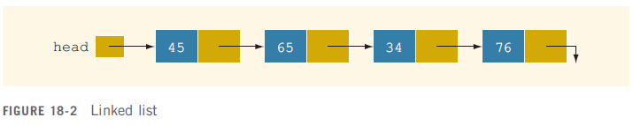
Linked Lists
Linked list: a list of items (nodes), in which the order of the nodes is determined by the address, called the link, stored in each node
Link field in last node
is NULL

Slide 12
Linked Lists
Because each node of a linked list has two components, we need to declare each node as a class or struct
Data type of a node depends on the specific application
The link component of each node is a pointer

Slide 13
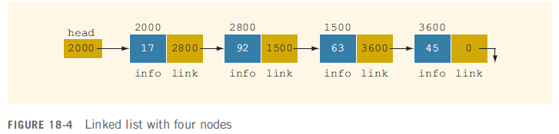
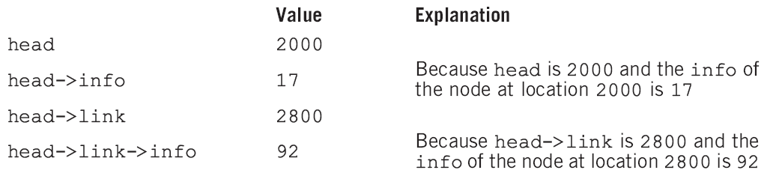
Linked Lists: Some Properties
//See Example 2.11

Slide 14
Linked List Operations
Basic operations:
add a node to the end of the list
insert a node within the list
traverse the linked list
Delete/remove a node from the list
delete/destroy the list

Slide 15
Linked Lists Operations
Nodes can be added or removed from the linked list during execution
Addition or removal of nodes can take place at beginning, end, or middle of the list
list
head
Add or delete node
NULL

Slide 16
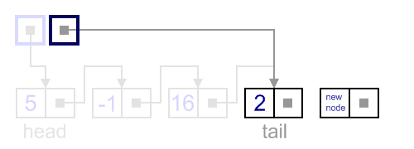
Insert a node next to the tail/end of the list
In this case, new node is inserted right after the current tail node.
//See Example 2.12, Example 2.12_display_loop

Slide 17
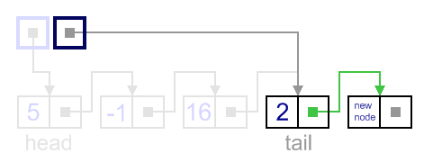
Insert a node next to the tail
It can be done in two steps:
Update the next link of the current tail node, to point to the new node.
//See Example 2.13, Example 2.13_display_loop

Slide 18
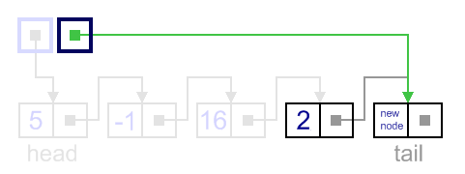
Insert a node next to the tail
Update tail link to point to the new node.
//See Example 2.14, Example 2.14_display_loop

Slide 19
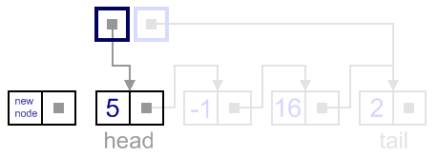
Insert a node in front of the head
In this case, new node is inserted right before the current head node.
//See Example 2.15

Slide 20
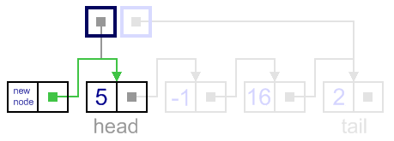
Insert a node in front of the head
It can be done in two steps:
Update the next link of a new node, to point to the current head node
//See Example 2.16

Slide 21
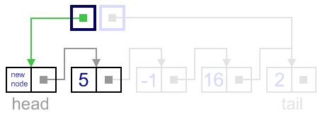
Insert a node in front of the head
Update head link to point to the new node.
//See Example 2.17

Slide 22
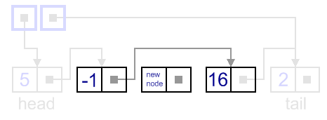
Insert in between element
In general case, new node is always inserted between two nodes, which are already in the list. Head and tail links are not updated in this case.

Slide 23
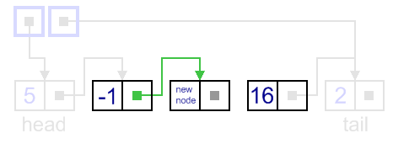
Insert in between element
Such an insert can be done in two steps:
Update link of the "previous" node, to point to the new node.

Slide 24
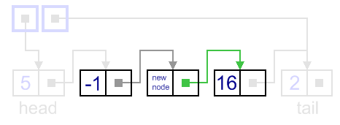
Insert in between element
//See Example 2.18

Slide 25
Linked Lists vs. Arrays and Vectors
Linked lists can grow and shrink as needed, unlike arrays, which have a fixed size
Unlike vectors, insertion or removal of a node in the middle of the list is very efficient
NULL
list
head

Slide 26
Traversal.
Algorithm
Beginning from the head, check, if the end of a list hasn't been reached yet;
do some actions with the current node, which is specific for particular algorithm;
current node becomes previous and next node becomes current. Go to the step 1.

Slide 27
Traversing a Linked List
List traversals visit each node in a linked list to display contents, validate data, etc.
Basic process of traversal:
set a pointer to the head pointer
while pointer is not NULL
process data
set pointer to the successor of the current node
end while

Slide 28
Traversing a Linked List
nodePtr
5
13
19
NULL
list
head
nodePtr points to the node containing 5, then the
node containing 13, then the node containing 19,
then points to NULL, and the list traversal stops

Slide 29
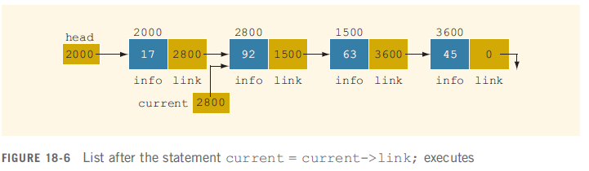
Example : Add a node using traversal algorithm
current = current->link;
//See Example 2.19

Slide 30


Example
As for example, let us see an example of summing up values in a singly-linked list.

Slide 31



//See Example 2.20

